Slide 1
BEM VINDOS!

Slide 2
http://www.pucrs.br/ideia/arduinoday

Slide 3
https://www.facebook.com/arduinodaypucrs

Slide 4
https://www.facebook.com/arduinodaypucrs

Slide 5
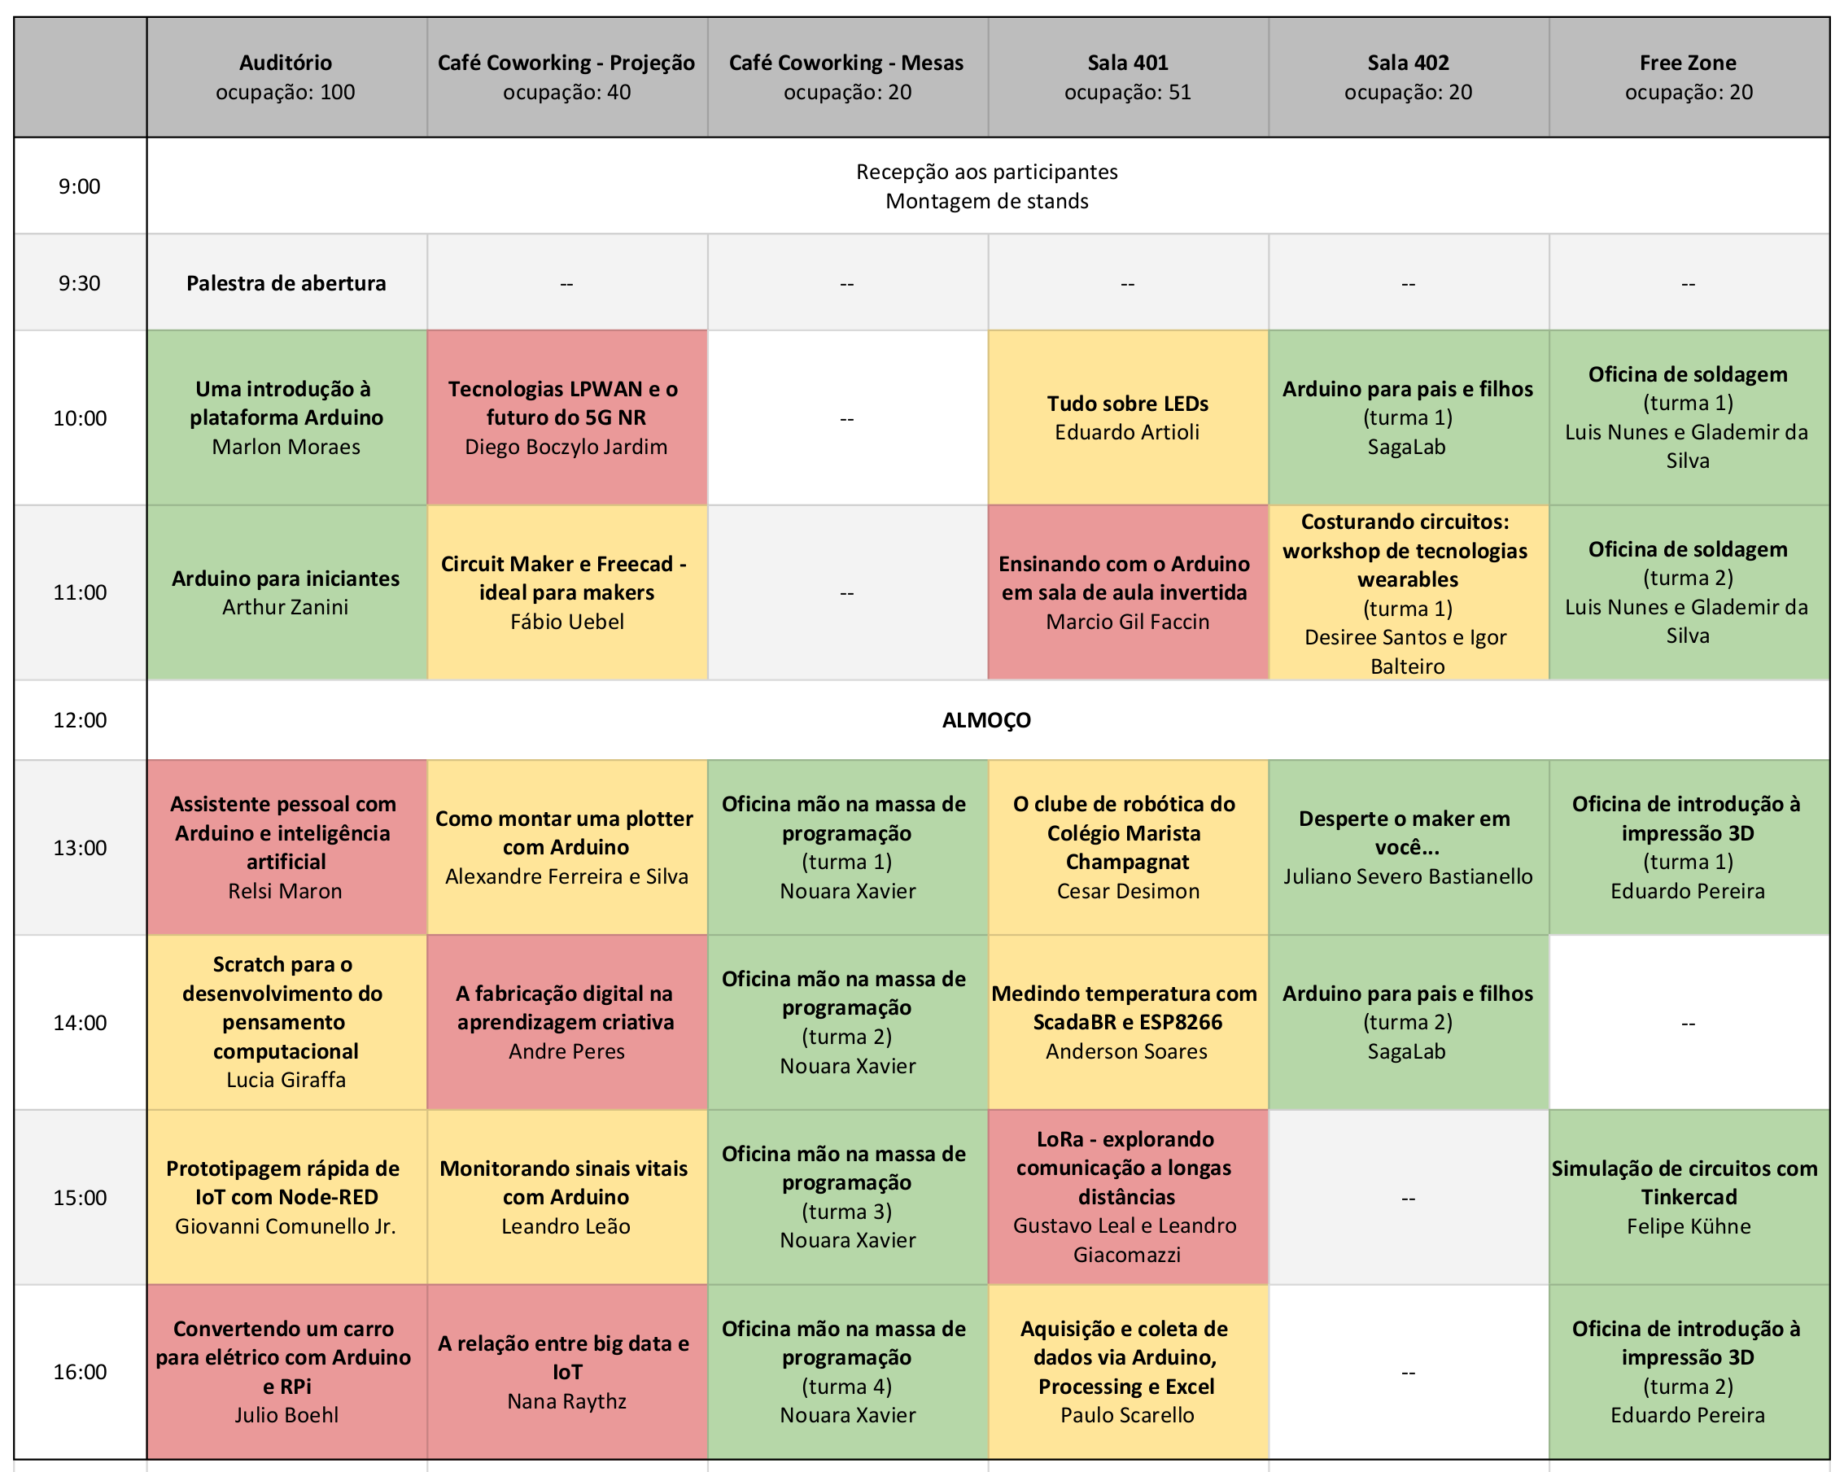

Slide 6
WIFI
Rede: PUCRS Eventos
Checkin pelo Facebook

Slide 7
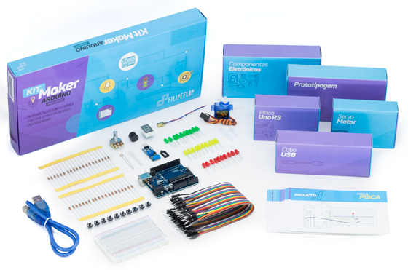


Slide 8
BEM VINDOS!

